Slide 1
Birth to 22: United for Bright Futures 2021 Taskforce Meeting Evaluation
Data Complied: January 4, 2022
Survey Open: December 20, 2021 – January 4, 2022
55 Total Responses

Slide 2
Key Highlights
98% of respondents agreed that the Taskforce Meeting increased their knowledge about Birth to 22’s work and objectives.
89% of respondents felt like genuine connections could be made with Birth to 22 teams and partners.
56% of respondents are currently involved with Birth to 22 through an Action Team or Work Group.
56% of respondents reported they are currently involved with Economic Access Action Team or Girls Coordinating Council.
11 respondents heard about the Taskforce Meeting from a County employee/representative and 11 respondents received an email and/or invitation for the Taskforce Meeting

Slide 3
Highlights of Needs in Our Community
“Equitable practices.”
“Gainful employment.”
“Living wages.”
“Safe, affordable housing for families with low-moderate income.”
“Innovative mental health services for youth.”
“Access to information regarding available services.”

Slide 4
Highlights of Strengths in our Community
“Programs for youth of all backgrounds.”
“We care for our youth and families.”
“Commitment to trauma informed care.”
“Providers and funders work on a common mission to serve youth.”
“People with passion and purpose.”
“Programs willing to collaborate.”
Trends from Question 13

Slide 5
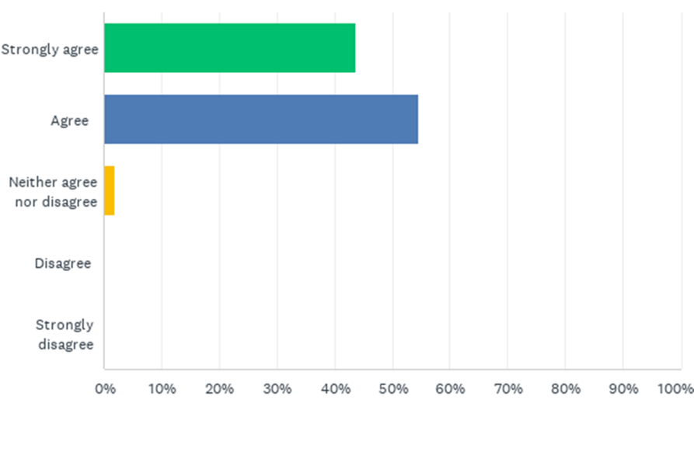
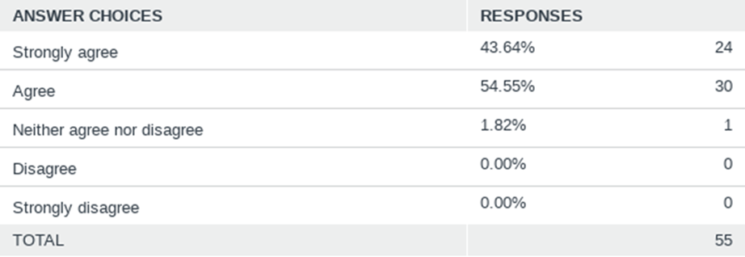
Q1: The Birth to 22’s Annual Task Force Meeting increased my knowledge about B-22’s work and its objectives.
Answered: 55 Skipped: 0

Slide 6
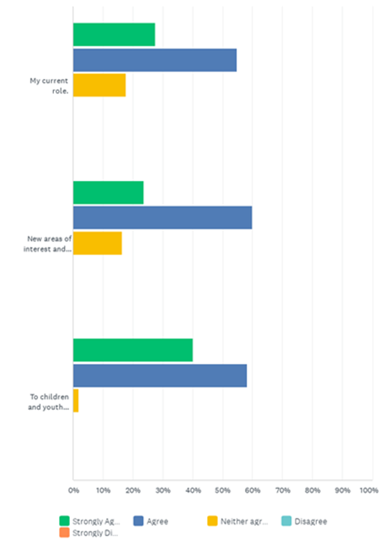
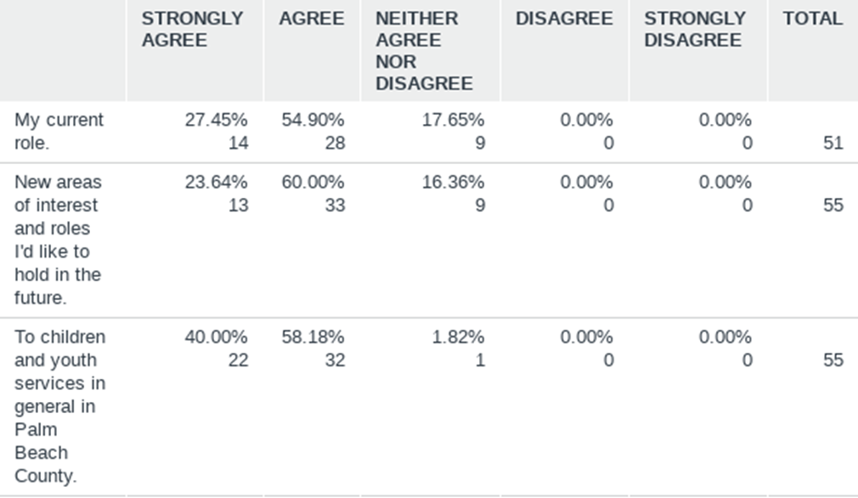
Q2: The meeting and breakout sessions were helpful to make connections to:
Answered: 55 Skipped: 0

Slide 7
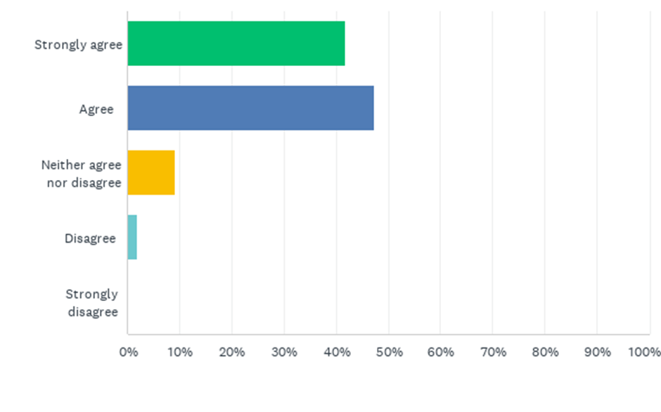
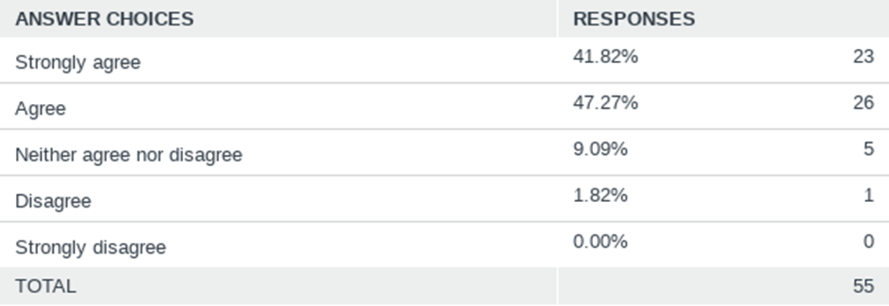
Q3: During the meeting, I felt like genuine connections could be made with Birth to 22 teams and partners.
Answered: 55 Skipped: 0

Slide 8
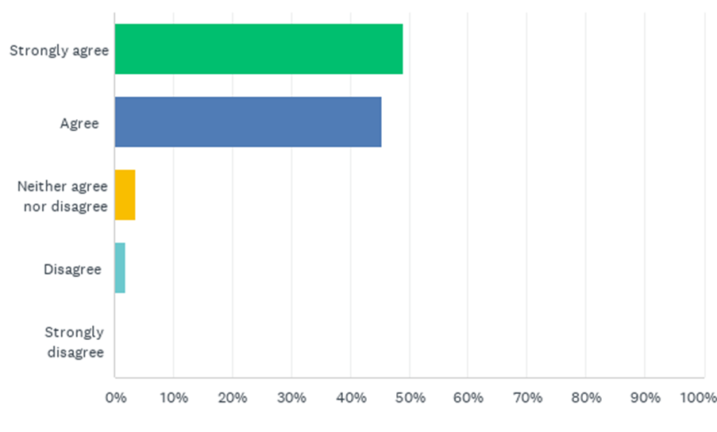
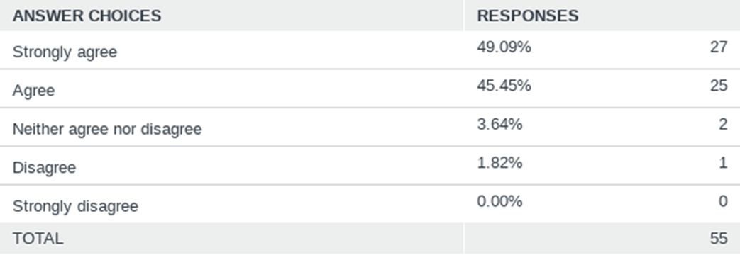
Q4: The 2022 identified priorities match where I think the Birth to 22 Alliance should be headed.
Answered: 55 Skipped: 0

Slide 9
Q5: Please share how the 2022 identified priorities differ from how you think the Birth to 22 Alliance should be headed.*
Answered: 1 Skipped: 54
*This question was only completed by anyone who reported disagreeing with Question 4.

Slide 10
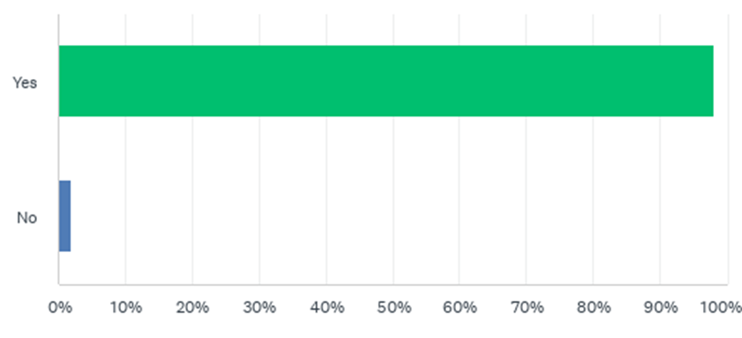
Q6: Based on my experience I would attend the 2022 Birth to 22 Annual Taskforce Meeting and invite others to attend as well.
Answered: 55 Skipped: 0

Slide 11
Q7: Please share why you will not attend the 2022 Birth to 22 Annual Taskforce Meeting or why you would not invite others to attend.*
Answered: 1 Skipped: 54
Respondent | Comment
1 | There is a lot of time wasted with mindfulness and not getting to the issues. Real work can be done but I think it’s good to hear from different perspectives.
*This question was only answered by those who responded “No” to Question 6.

Slide 12
Q8: How did you hear about the 2021 Taskforce Meeting?
Answered: 52 Skipped: 3
Respondent | Response
1. | Manager & Colleague
2. | CPSFL Leadership
3. | I’m involved in a taskforce
4. | COUNTY REPRESENTATIVE
5. | Invitation
6. | Active active service provider
7. | Invitation from PBC Youth Services
8. | Mr. Wil Romelus my Executive Director, Valerie Messineo and Ike Powell of the Palm Beach County Youth Services Dept.
9. | Through work
10. | Youth Services Department Announcement and Girls Coordinating Council.
11. | With the company, I work with ELC and Rachel Mondesir
12. | Email
13. | I am on the Coordination Team.
Respondent | Response
14. | CBA Quarterly Meeting.
15. | I am a partner organization.
16. | Invitation send by Palm Beach County Youth Services Department
17. | Coworker
18. | My co-worker
19. | Tammy Fields
20. | Been to them all!
21. | CareerSource
22. | Email from a colleague.
23. | From my employer
24. | Via email promotion
25. | Colleague
26. | We have been part of birth to 22 for awhile

Slide 13
Q8: How did you hear about the 2021 Taskforce Meeting? (continued)
Answered: 52 Skipped: 3
Respondent | Response
27. | Colleague
28. | B22 coordination meeting
29. | CSC
30. | Through committee meetings
31. | Taskforce Members
32. | We are a service provider, and our children and staff participated in various meetings.
33. | Work mandatory
34. | Email
35. | Through PBC Youth Services Department
36. | Invititation
37. | The Director of Quality Programs from Early Learning Coalition sent the invitation and I am not sure who invited her.
38. | From another nonprofit leader who is already part of the team, Jeff Demario.
39. | YSD
Respondent | Response
40. | Through Birth to 22 workgroups and email
41. | Email
42. | CBA Contract Manager and PBC UW Mentor Center Network!!!
43. | Partner organization
44. | Invitation
45. | Have been a part of the taskforce for 5 years.
46. | Children Youth Services Department
47. | Work
48. | Email
49. | Email
50. | Employer
51. | Committee
52. | PBC VS

Slide 14
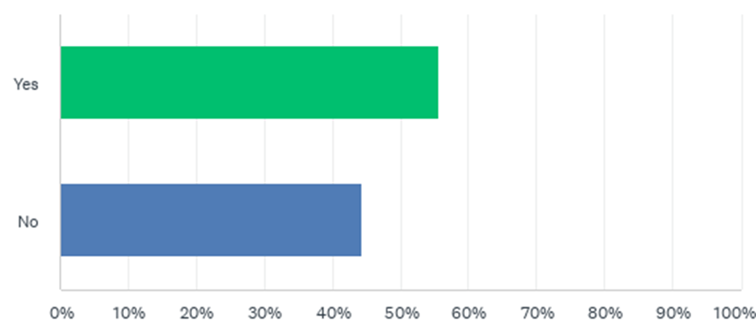
Q9: Are you currently involved with Birth to 22 through an Action Team or Work Group?
Answered: 54 Skipped: 1

Slide 15
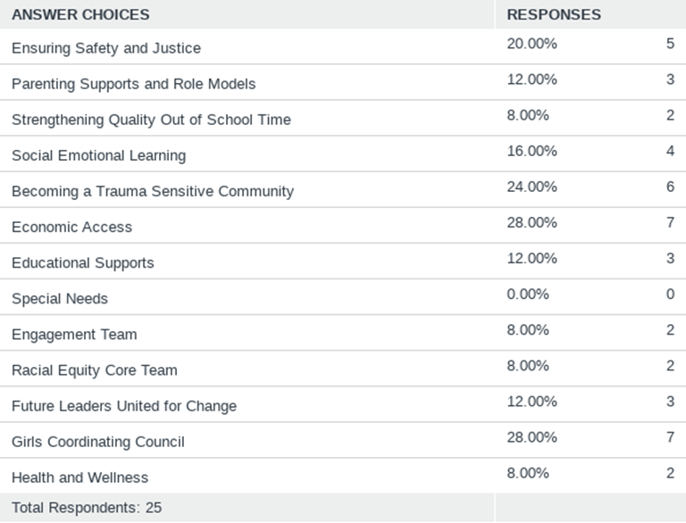
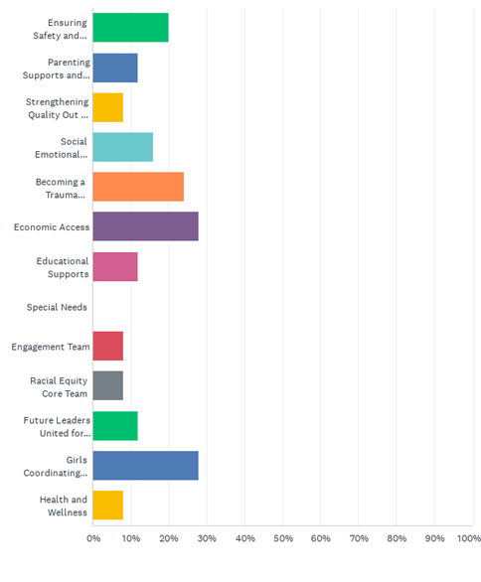
Q10: Please select all teams you are currently involved in:*
Answered: 25 Skipped: 30
*This question was only answered by those who responded “Yes” to Question 9.

Slide 16
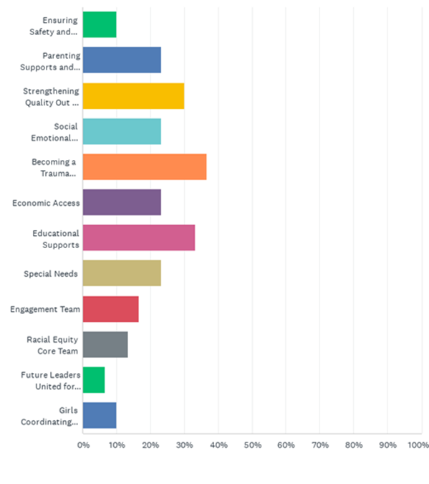
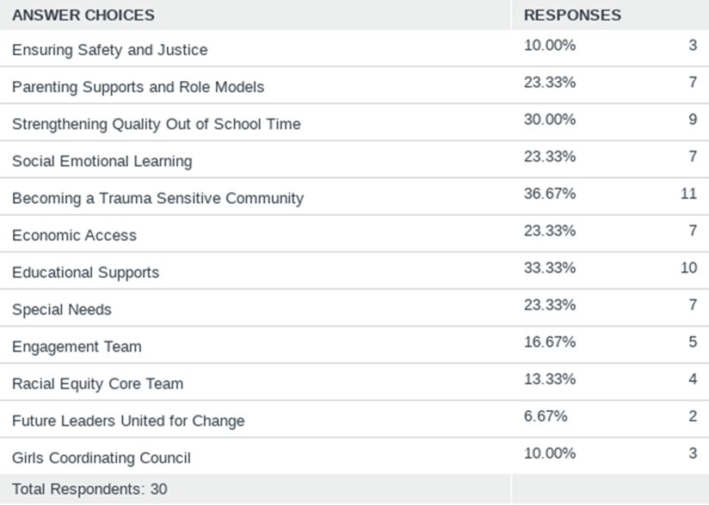
Q11: I would like more information about joining an Action Team or Work Group (select the area of interest):
Answered: 30 Skipped: 25
*This question was only answered by those who responded “No” to Question 9.

Slide 17
Q12: Please identify the three most important needs of our community: (open-ended responses)
Answered: 35 Skipped: 20
Respondent | Need 1 | Need 2 | Need 3
1. | Equity & Access to available supports | Streamlined Process to receive support | Increasing the awareness of the support that is available
2. | Health and wellness | Economic Access | Racial Equity
3. | READING INSTRUCTION | READING INTERVENTION | PARENT TRAINING IN PROVIDING READING SUPPORT EAT HOME
4. | Community Connections | Smooth Systems that are easy and welcoming | Community feedback
5. | Economic access for youth and their families | Youth employment | College and career opportunities access
6. | Lack of instruction regarding community resources | Opportunity for community feedback and outreach during reasonable hours | Positive community engagement from state, local and government agencies
7. | Racial Equity | Economic support | Access to services
8. | Education | Opportunity
9. | Homeless Support for Families with children | Emergency basic needs fund for all community members | Food
10. | Employment opportunities | Educational supports | Racial equity
11. | Students need to some how get caught up on work / learning that was missed during Virtual School. | Access to healthy and affordable food | OST Employees - How do we get people comfortable working with kids again / how do we balance out the salary gap for OST employees (i.e. Aldi's is $19.50 / hr.)
12. | Graduation | Increased mental and behavioral health issues in youth | Increased violence based on number 2
13. | Mental Health providers for Schools | Trauma sensitive on going training | Resources for youth caregivers at Middle and High Schools

Slide 18
Q12: Please identify the three most important needs of our community: (continued open-ended responses)
Answered: 35 Skipped: 20
Respondent | Need 1 | Need 2 | Need 3
14. | Food security | Affordable housing | Access to mental health care
15. | Mental health | equity | access to wrap around services
16. | Behavioral health supports, including medication management | Access to basic needs
17. | Access to employment | Acess to translators to assist with jobs/medical/economic assistance | Assistance with housing
18. | safe, affordable housing for families with low-moderate income | access to affordable mental/behaviorial health services | racial inequities
19. | Affordable housing | Homelessness | Innovative Mental health services for youth
20. | Affordable housing | Economic stability | Educational alternatives for elementary and middle schoolers
21. | Affordable Housing | Safe Spaces | Mental Health Supports
22. | Access to youth employment | Access to career planning | Access to financial support for college or technical schools
23. | Security | Education | Jobs opportunities
24. | Safety (emotional, physical, mental) | Gainful employment | Equitable, quality healthcare
25. | Health Equity | Respite for Special Needs parents | Equitable housing
26. | Educating parents on the importance of engagement | Support families with special needs children | Single mom and dad financial support

Slide 19
Q12: Please identify the three most important needs of our community: (continued open-ended responses)
Answered: 35 Skipped: 20
Respondent | Need 1 | Need 2 | Need 3
27. | Coordinated care / collaboration among service providers | Access to information regarding available services | Better "gap" coverage - support while waiting for services
28. | Equitable practices
29. | Parenting | Adequate Policing | Mentoring --Male Role Models --Firefighters --Police --EMTs
30. | Wellness | Equity | Educational recovery of Covid time
31. | Teen youth engagement and opportunities | Student supports in schools | Business sector involvement
32. | Affordable housing | Living wages | Access to health services
33. | An established K-12 Social Emotional Learning curriculum | Increased parental involvement in furthering children's social emotional and academic development | Creating racial equity throughout our society
34. | Out of School Time | Becoming a Trauma Sensitive Community | Educational Supports
35. | Housing | Health | Employment

Slide 20
Q13: Please identify the three biggest strengths of our community: (open-ended responses)
Answered: 32 Skipped: 23
Respondent | Need 1 | Need 2 | Need 3
1. | Agencies in the community work together | Commitment of the community partners | Diversity in the support that is offered
2. | Attractive destinations and physical climate to build a great infrastructure | Ever moving economy during the Pandemic due to the weather | People that care
3. | RESOURCES AVAILABLE TO THE COMMUNITY | COLLABORATION AMONG AGENCIES | TARGETED SUPPORT FOR ALL STAKEHOLDERS
4. | Resources | Dedicated staff and leaders | Funding
5. | We care for our youth and families. | Service providers shared a common bond. | Our funders and providers are in this together.
6. | Community Resources available to the public | Gang and crime prevention task forces
7. | Strong leaders | Innovation | Growing interconnectedness of organizations
8. | Resources | Community
9. | Community partnerships
10. | Caring Adults | Programs for youth of all backgrounds | Funding for youth programs
11. | Collective work | Focus | Ability to share resources
12. | Unity | Programs willing to collaborate | Education
13. | Coordinated community partners | Funding | Available resources

Slide 21
Q13: Please identify the three biggest strengths of our community: (continued open-ended responses)
Answered: 32 Skipped: 23
Respondent | Need 1 | Need 2 | Need 3
14. | Community involvement/coordination | Commitment to trauma informed care | Support of PBC government
15. | Collaborative spirit | Focus on diversity and equity
16. | Employment Assistance | Opportunities for young Adults | Several programs available for all
17. | People with passion and purpose | Weather - since we have so many unhoused individuals | Collaboration
18. | Funding | County involvement with youth | People who care about others
19. | Community Partnerships | Access to outpatient mental health | Access to substance abuse centers- though not affordable
20. | Collaboration
21. | Connecting with other youth service organizations | Providers and funders work on a common mission to serve youth. | Passionate leaders and staff
22. | Latin family oriented | Previous experience in difficult situation | Strong sense of hope
23. | Youth voice | Equity efforts | Community collaboration
24. | Collaboration | Funding | Innovation
25. | NA | NA | NA
26. | Abundance of services available | People who truly care | Strong County Community services team

Slide 22
Q13: Please identify the three biggest strengths of our community: (continued open-ended responses)
Answered: 32 Skipped: 23
Respondent | Need 1 | Need 2 | Need 3
27. | Leadership | Community Activism
28. | Networking!!!! | Teamwork--Collaborations!!!! | Motivated --Passion --Proactiveness
29. | Coordination | Resources | Diversity
30. | Committed individuals/orgs | Diversity of group | Resources
31. | Diversity | Local funding | Collaborative relationships
32. | Resources | Communication | People who care

Slide 23
Next Steps
Distribute Connection Card Response to Action Areas & Work Groups
Review Results with Coordination Team
Date of Task Force Meeting is close to holidays and low response rate may have been influenced by partners being out of office.
Identify if Current Needs match Youth Master Plan and compare to Needs identified in upcoming Community Conversations
Strengths listed by respondents focused on provider strengths, discuss rewording question to understand strengths of community outside of providers/resources.

